Slide 1
BRAIN TEASER FOR HIGH SCHOOL
Here is where your presentation begins

Slide 2
CONTENTS OF THIS TEMPLATE
Here’s what you’ll find in this Slidesgo template:
A slide structure based on a multi-purpose presentation for education, which you can easily adapt to your needs. For more info on how to edit the template, please visit Slidesgo School or read our FAQs.
An assortment of pictures and illustrations that are suitable for use in the presentation can be found in the two alternative resources slides.
A thanks slide, which you must keep so that proper credits for our design are given.
A resources slide, where you’ll find links to all the elements used in the template.
Instructions for use.
Final slides with:
The fonts and colors used in the template.
A selection of illustrations. You can also customize and animate them as you wish with the online editor. Visit Storyset by Freepik to find more.
More infographic resources, whose size and color can be edited.
Sets of customizable icons of the following themes: general, business, avatar, creative process, education, help & support, medical, nature, performing arts, SEO & marketing, and teamwork.
You can delete this slide when you’re done editing the presentation.

Slide 3
TABLE OF CONTENTS
01
02
03
04
INTRODUCTION
COMPANY
Here you could describe the topic of the section
Here you could describe the topic of the section
ANALYSIS
CONCLUSION
Here you could describe the topic of the section
Here you could describe the topic of the section

Slide 4
WHOA !
This could be the part of the presentation where you can introduce yourself, write your email…

Slide 5
—SOMEONE FAMOUS
“This is a quote, words full of wisdom that someone important said and can make the reader get inspired.”

Slide 6
01
INTRODUCTION
You can enter a subtitle here if you need it

Slide 7
DO YOU KNOW WHY BRAIN TEASERS ARE GOOD FOR YOUR BRAIN?
Do you know what helps you make your point clear? Lists like this one:
They’re simple
You can organize your ideas clearly
You’ll never forget to buy milk!
And the most important thing: the audience won’t miss the point of your presentation

Slide 8
WHERE ARE WORDS “STORED” IN YOUR BRAIN?
A
B
MERCURY
VENUS
Mercury is the closest planet to the Sun and the smallest one
It has a beautiful name and is the second planet from the Sun

Slide 9
WAYS OF SOLVING BRAIN TEASERS
MARS
JUPITER
SATURN
Mars is actually a very cold place
It’s a gas giant and the biggest planet
Saturn is a gas giant and has rings
01
02
03

Slide 10

A PICTURE ALWAYS REINFORCES THE CONCEPT
Images reveal large amounts of data, so remember: use an image instead of a long text

Slide 11
254,125
Big numbers catch your audience’s attention

Slide 12
SUCCESS RATE DOING BRAIN TEASERS
60%
MARS
Mars is actually a very cold place
40%
JUPITER
It’s a gas giant and the biggest planet

Slide 13
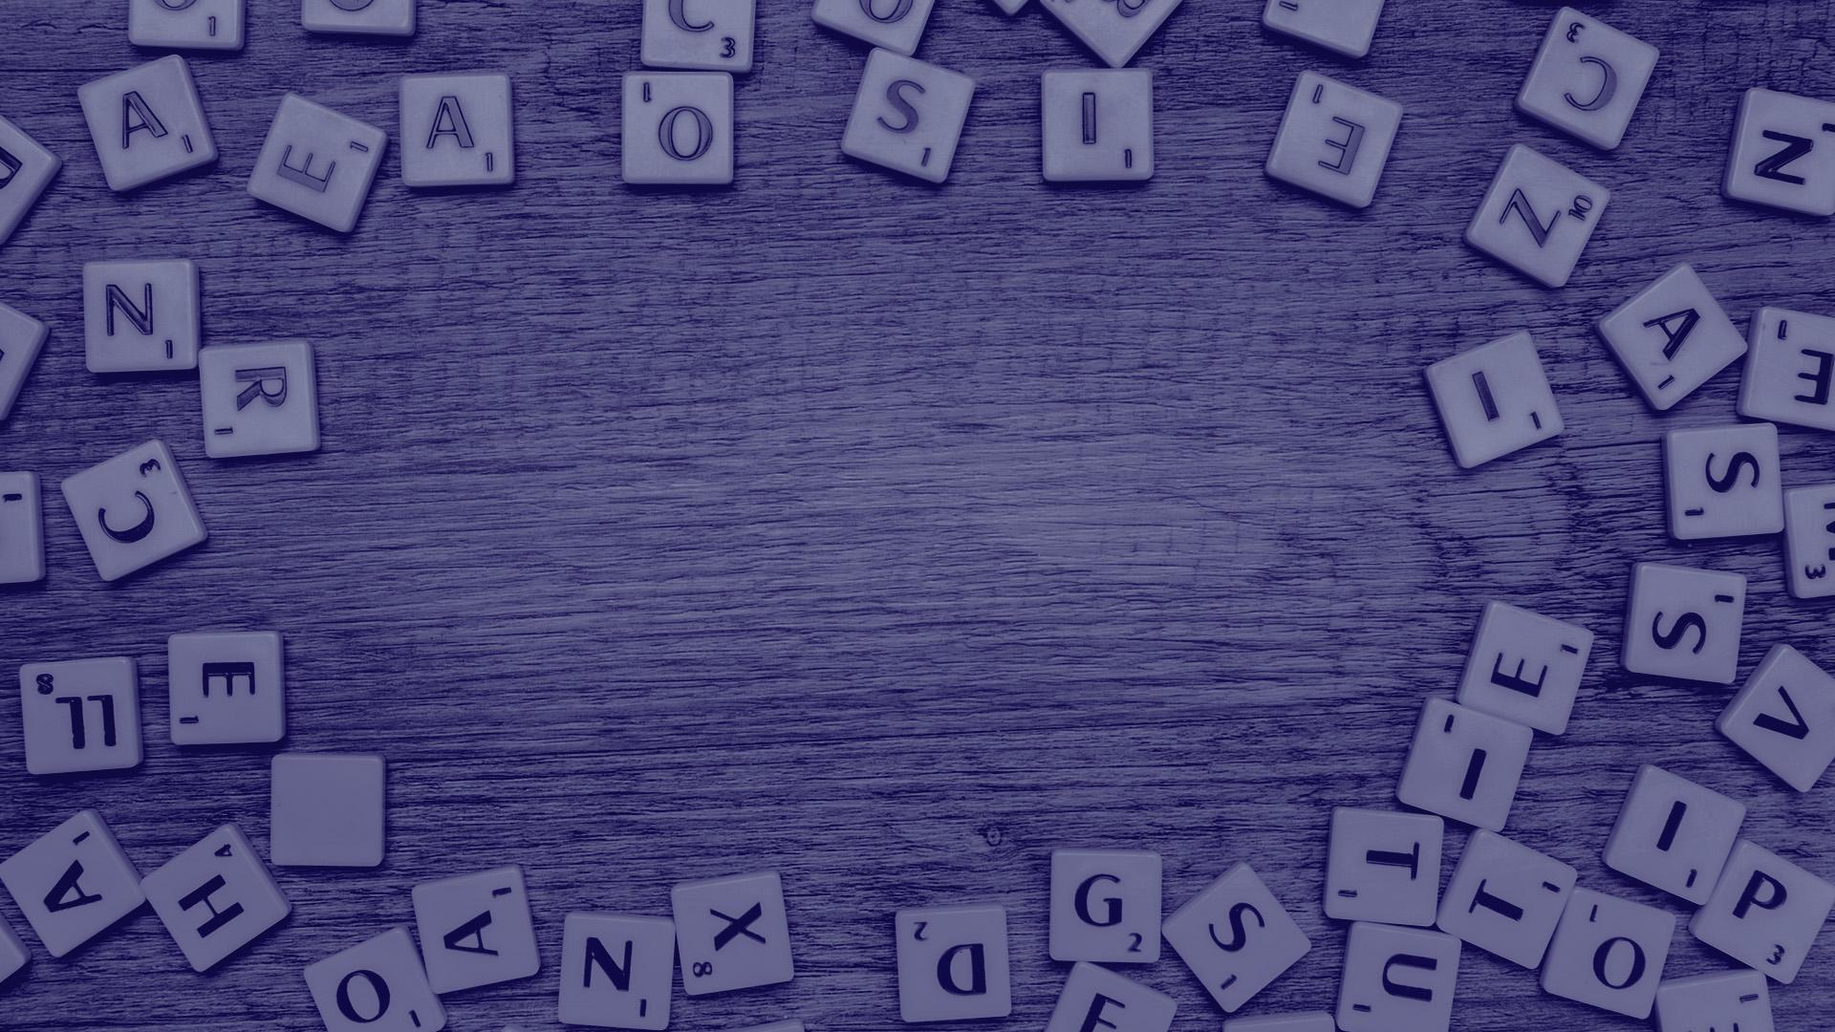
A PICTURE IS WORTH A THOUSAND WORDS

Slide 14
SOME NUMBERS
Do you know which number is missing on each line?
16
06
68
88
?
98
01
03
05
02
04
?

Slide 15
AWESOME WORDS

Slide 16
TEST YOUR BRAIN!
5 | 3 |  |  | 7
6 |  |  | 1 | 9 | 5
 | 9 | 8 |  |  |  |  | 6
8 |  |  |  | 6 |  |  |  | 3
4 |  |  | 8 |  | 3 |  |  | 1
7 |  |  |  | 2 |  |  |  | 6
 | 6 |  |  |  |  | 2 | 8
 |  |  | 4 | 1 | 9 |  |  | 5
 |  |  |  | 8 |  |  | 7 | 9
The goal is to fill in the empty cells, with a number in each of them, so that each column, row, and region contains the numbers 1–9 only once

Slide 17
LET’S SOLVE THIS!
In a year, there are 21 months. Seven months have 31 days. How many months have 28 days?
A
B
C
ONE MONTH
THREE MONTHS
ALL
Mars is actually a very cold place
It’s a gas giant and the biggest planet
Saturn is a gas giant and has rings

Slide 18
TYPES OF BRAIN TEASERS
40%
20%
MYSTERY
PHRASES
Mars is actually a cold place
Venus has a beautiful name
100%
30%
10%
CROSSWORDS
MATHEMATICAL
It’s a gas giant and the biggest
Yes, this is the ringed one

Slide 19
LET’S COUNT!
Can you count the “S” in the following sentences? Write the number below each one
MARS
JUPITER
SATURN
Mars is actually a very cold place
It’s a gas giant and the biggest planet
Saturn is a gas giant and has rings
1
?
?
MERCURY
VENUS
NEPTUNE
Mercury is the closest planet to the Sun
It has a beautiful name, but it’s hot
It’s the farthest planet from the Sun
?
?
?

Slide 20
ANSWER THIS RIDDLE: THE BLIND BEGGAR
A blind beggar had a brother who died. What relation had the blind beggar with the brother who died? “Brother” is not the answer.
BROTHER
FRIEND
Mars is actually a very cold place
It’s a gas giant and the biggest planet
SISTER
FATHER
Mercury is the closest planet to the Sun
Venus is the second planet from the Sun
Check the answer on the next slide!

Slide 21
EXPLANATION AND ANSWER
The blind beggar was the sister of her brother, who died
This puzzle is very simply stated and yet stumps those who have not heard it before, because the listener tends to make an implicit assumption about gender — in this case that a blind beggar is a man

Slide 22
COULD YOU RECOGNIZE THESE COUNTRIES?
Write the names of the countries selected
COUNTRY 1
It’s the closest planet to the Sun
COUNTRY 2
Venus has a beautiful name
COUNTRY 3
It’s a gas giant and the biggest planet

Slide 23
LET'S CALCULATE!
Follow each column to calculate the number!
25 | 50 | 75 | 100 | 42
X5 | x3 | X5 | x3 | X5
/10 | /4 | /10 | /4 | /10
=12.5 | ? | ? | ? | ?

Slide 24
WHO WILL LEAVE IN LESS MOVEMENTS
Complete each one and write how many movements are needed
This one can be done in _ movements
This one can be done in _ movements

Slide 25
ARE THEY TRUE OR FALSE?
Could you tell which ones are true and which ones are false?
TRUE/FALSE
TRUE/FALSE
Mars is actually a very cold place
Jupiter is the smallest of them all
TRUE/FALSE
TRUE/FALSE
Mercury is the closest planet to the Sun
Venus is the second planet from the Sun

Slide 26
MEMORIZING PROCESS
SATURN
NEPTUNE
Yes, this is the ringed one. It’s a giant
It’s the farthest planet from the Sun
01
02
03
04
VENUS
MARS
Venus has a beautiful name, but it’s hot
Mars is actually a very cold place

Slide 27
HOW MANY NUMBERS CAN YOU SPOT?
Write on the table below the numbers you spot on this sequence:
5415123214521236555415123214521236555415121452123655541512321452123655541512321452123655
1 | 2 | 3 | 4 | 5
There are 20 | ? | ? | ? | ?

Slide 28
WILL YOU GET IT IN TEN SECONDS?
Continue the pink line to get in!

Slide 29
333,000.00
24h 37m 23s
386,000 km
earths is the Sun’s mass
is Jupiter’s rotation period
is the distance between Earth and the Moon

Slide 30
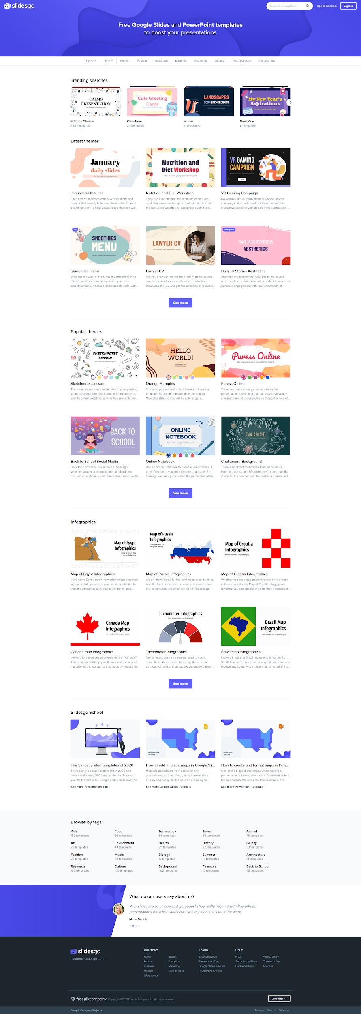
DESKTOP SOFTWARE
You can replace the image on the screen with your own work

Slide 31
TABLET APP
You can replace the image on the screen with your own work

Slide 32
MOBILE WEB
You can replace the image on the screen with your own work

Slide 33
LIST THE PLANETS FROM THE SUN
Write here the planet that is part of the Solar System
Write here the planet that is part of the Solar System
Write here the planet that is part of the Solar System
Write here the planet that is part of the Solar System
Write here the planet that is part of the Solar System
Write here the planet that is part of the Solar System
Write here the planet that is part of the Solar System
Write here the planet that is part of the Solar System
Write here the planet that is part of the Solar System

Slide 34

RESULTS
20%
MARS
Mars is actually a very cold place
30%
MERCURY
It’s the closest planet to the Sun
50%
JUPITER
It’s a gas giant and the biggest planet
To modify this graph, click on it, follow the link, change the data and paste the new graph here

Slide 35


OUR TEAM
JENNA DOE
JOHN SMITH
You can replace the image on the screen with your own
You can replace the image on the screen with your own

Slide 36
THANKS
Do you have any questions?
Your email@freepik.com
+91 620 421 838 yourcompany.com
Please keep this slide for attribution

Slide 37
ALTERNATIVE RESOURCES

Slide 38
ALTERNATIVE RESOURCES
PHOTOS
Side view medium shot teenage boy showing
College student girl in library
Friends in library
Girl with boy reading

Slide 39
RESOURCES
PHOTOS
VECTORS
Letters with space in middle
Smiling girl in library
Teen boy with book
College students in library
Business concept with flat labyrinth
Business concept with flat labyrinth
Geometric background

Slide 40
Instructions for use
In order to use this template, you must credit Slidesgo by keeping the Thanks slide.
You are allowed to:
- Modify this template.
- Use it for both personal and commercial projects.
You are not allowed to:
- Sublicense, sell or rent any of Slidesgo Content (or a modified version of Slidesgo Content).
- Distribute Slidesgo Content unless it has been expressly authorized by Slidesgo.
- Include Slidesgo Content in an online or offline database or file.
- Offer Slidesgo templates (or modified versions of Slidesgo templates) for download.
- Acquire the copyright of Slidesgo Content.
For more information about editing slides, please read our FAQs or visit Slidesgo School:
https://slidesgo.com/faqs and https://slidesgo.com/slidesgo-school

Slide 41
Fonts & colors used
This presentation has been made using the following fonts:
Ubuntu
(https://fonts.google.com/specimen/Ubuntu)
Raleway
(https://fonts.google.com/specimen/Raleway)
#00003e
#03d6f9
#ff0279
#c36eff

Slide 42





Storyset
Create your Story with our illustrated concepts. Choose the style you like the most, edit its colors, pick the background and layers you want to show and bring them to life with the animator panel! It will boost your presentation. Check out How it Works.
Pana
Amico
Bro
Rafiki
Cuate

Slide 43
Use our editable graphic resources...
You can easily resize these resources without losing quality. To change the color, just ungroup the resource and click on the object you want to change. Then, click on the paint bucket and select the color you want. Group the resource again when you’re done. You can also look for more infographics on Slidesgo.

Slide 46
JANUARY
FEBRUARY
MARCH
APRIL
MAY
JUNE
PHASE 1
Task 1
Task 2
PHASE 2
Task 1
Task 2
JANUARY
FEBRUARY
MARCH
APRIL
PHASE 1
Task 1
Task 2

Slide 49
...and our sets of editable icons
You can resize these icons without losing quality.
You can change the stroke and fill color; just select the icon and click on the paint bucket/pen.
In Google Slides, you can also use Flaticon’s extension, allowing you to customize and add even more icons.

Slide 50
Educational Icons
Medical Icons

Slide 51
Business Icons
Teamwork Icons

Slide 52
Help & Support Icons
Avatar Icons

Slide 53
Creative Process Icons
Performing Arts Icons

Slide 54
Nature Icons

Slide 55
SEO & Marketing Icons

Slide 56


